Slide 1


CONTEXTUAL VERIFICATION AND SEO SCORING OF A WEBSITE
21CSE356T - NATURAL
LANGUAGE PROCESSING
ADITYA MURALIDHARAN [RA2212704010012]
SIMRAN [RA2212704010034]

Slide 2


INTRODUCTION
Website content plays a crucial role in shaping brand perception, user engagement, and SEO performance. Our Website NLP Analysis Tool leverages Natural Language Processing (NLP) to analyze webpage metadata, keywords, and sentiment, providing actionable insights to optimize online presence.
By applying NLP techniques, our system can automatically extract, process, and evaluate content quality, ensuring businesses:
Improve SEO rankings by identifying missing or ineffective keywords
Analyze sentiment to understand how users perceive their content
Optimize metadata (title tags, descriptions) for better search visibility
Detect content gaps that impact engagement and conversions.
With real-time analysis and a structured scoring system, businesses can make data-driven improvements to their web content, enhancing both searchability and audience impact.

Slide 3

PROBLEM STATEMENT
Businesses face significant challenges in analyzing and extracting meaningful insights from vast amounts of unstructured website content. Webpages, blog articles, product descriptions, and other online materials contain valuable sentiment and keyword-related information, but manual analysis is inefficient, inconsistent, and lacks scalability.

Slide 4

Without an automated NLP-powered analysis, organizations struggle to:
❌ Identify missing keywords crucial for SEO optimization
❌ Assess the sentiment and tone of their website content
❌ Detect poorly structured metadata that impacts search rankings
❌ Make data-driven improvements to enhance user engagement
Our Website NLP Analysis Tool addresses this gap by leveraging Natural Language Processing (NLP) techniques to automatically extract metadata, analyze keywords, assess sentiment, and calculate a content score, helping businesses optimize their web presence efficiently and effectively.

Slide 5


OBJECTIVE
✔ Develop an automated Website NLP Analysis Tool using Natural Language Processing (NLP) to analyze web content, extract metadata, assess keyword relevance, and classify sentiment as positive, negative, or neutral.
✔ Design a scalable architecture capable of processing and analyzing large volumes of website data in real-time to improve efficiency and accuracy.
✔ Ensure a high accuracy rate (85% or higher) in sentiment classification by leveraging advanced NLP techniques and benchmarking against human analysis.

Slide 6


OBJECTIVE
✔ Deliver actionable insights through detailed reports and visualizations, helping businesses optimize their website content, improve SEO, and enhance user engagement.
✔ Enable trend analysis over time, allowing organizations to track keyword performance, sentiment shifts, and content effectiveness across different product/service categories.

Slide 7

Our Website NLP Analysis Tool follows a structured multi-layered architecture to ensure efficient processing, analysis, and storage of web content data.
1. Data Collection Layer
Fetches webpage content via URL submissions.
Extracts metadata, keywords, and textual content for analysis.
2. Preprocessing Module
Cleans raw text (removes HTML tags, special characters).
Performs tokenization, stopword removal, and feature extraction to prepare data for NLP processing.
SYSTEM ARCHITECTURE

Slide 8
3. Analysis Engine
Utilizes a hybrid NLP approach (lexicon-based + machine learning) for keyword analysis and sentiment classification.
Determines the tone of the webpage (positive, neutral, negative) and evaluates keyword relevance.
4. Storage Layer
Uses a NoSQL database to store raw text, metadata, extracted keywords, sentiment scores, and final analysis results.
5. API Layer
Provides a RESTful API for seamless integration with external business systems or additional analytics platforms.
6. Visualization Dashboard
An interactive web interface displaying:
✅ Metadata & keyword scores
✅ Sentiment trends & missing keyword detection
✅ Overall NLP-based webpage quality score
7. Alert System
Automated notifications for critical insights such as:
🚨 Negative sentiment detection
🚨 Missing crucial SEO keywords
🚨 Drastic content score changes over time

Slide 9
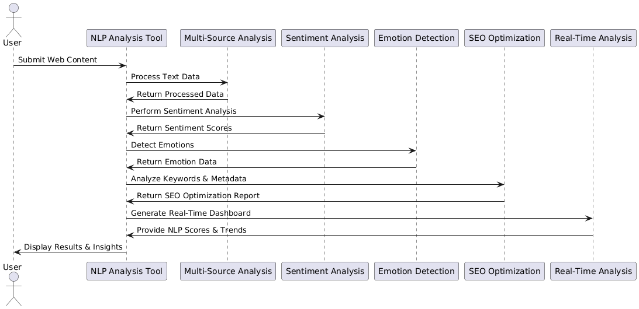

Slide 10

FEATURES AND FUNCTIONALITIES
Our Website NLP Analysis Tool is designed to provide comprehensive insights into web content through advanced Natural Language Processing (NLP) techniques. The key features include:
1. Multi-Source Analysis
Processes text from various online sources, including:
✅ Webpages (blogs, landing pages, product descriptions)
✅ SEO metadata (title tags, meta descriptions, keywords)
✅ Customer reviews, testimonials, and feedback forms.
2. Aspect-Based Sentiment Analysis
Analyzes sentiment toward specific content aspects,
such as:
✅ Product/service descriptions
✅ Brand messaging & tone
✅ Keyword effectiveness in SEO

Slide 11


FEATURES AND FUNCTIONALITIES
3. Emotion Detection
Goes beyond positive/negative/neutral classification to detect detailed emotions like:
✅ Happiness 😊
✅ Anger 😡
✅ Trust 🤝
✅ Frustration 😖
✅ Uncertainty 🤔
4. Multilingual Support
Supports website analysis in multiple languages, including:
English, Spanish, German, French and Mandarin.
5. SEO & Keyword Optimization
Detects missing or underutilized keywords for improved search rankings.
Evaluates keyword density, placement, and relevance.
6. Real-Time Analysis & Reporting
Provides instant NLP scores, sentiment analysis, and recommendations for content improvement.
Visual dashboard for keyword performance tracking & sentiment trends.

Slide 12

THANK YOU

